Slide 1
FYP5: Object Detection, Tracking and Suspicious Activity Recognition for Maritime Surveillance using Thermal Vision

Slide 2
Weekly Tasks
TRN network training.
CornerNet-Lite training
Try to simulate control system with online arduino based simulator Tinkercad
Work on the Feasibility Study report and presentation

Slide 3
Comparisons between Object Detectors
Model Name | Iterations | Backborn Structure | Inference time (per image) - s | mAP (%)
CenterNet | 14500 | Hourglass-104 | 0.5 | 88.0
CornerNet-Lite | 14000 | Squeezed Hourglass | 0.176 | 81.6

Slide 4
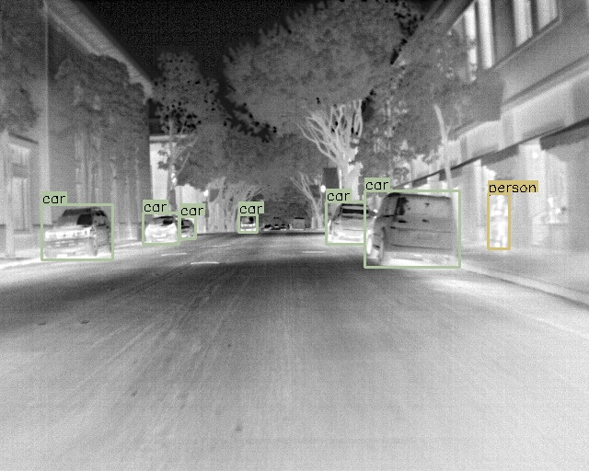
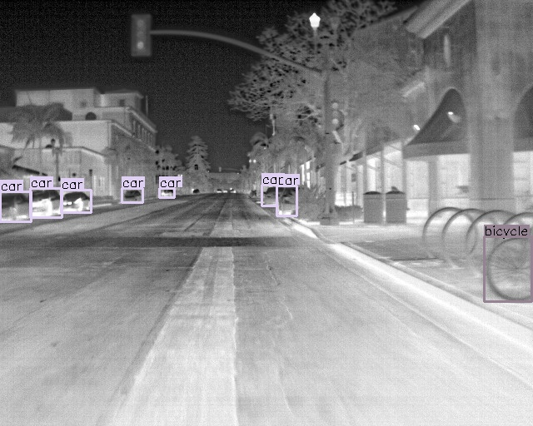

Slide 5
Action Detection
1. TRN
Resumed training with the earlier dataset for 61 epochs
Derived a new subset from THUMOS and extracted frames
Extracted optical flows per chunk using 6 frames by Farneback Algorithm
Extracted RGB features and Optical flow features using ResNet152 and Inception_v3
Trained from scratch on new features to try and recreate their original results
Training was carried out in 3 paths

Slide 6
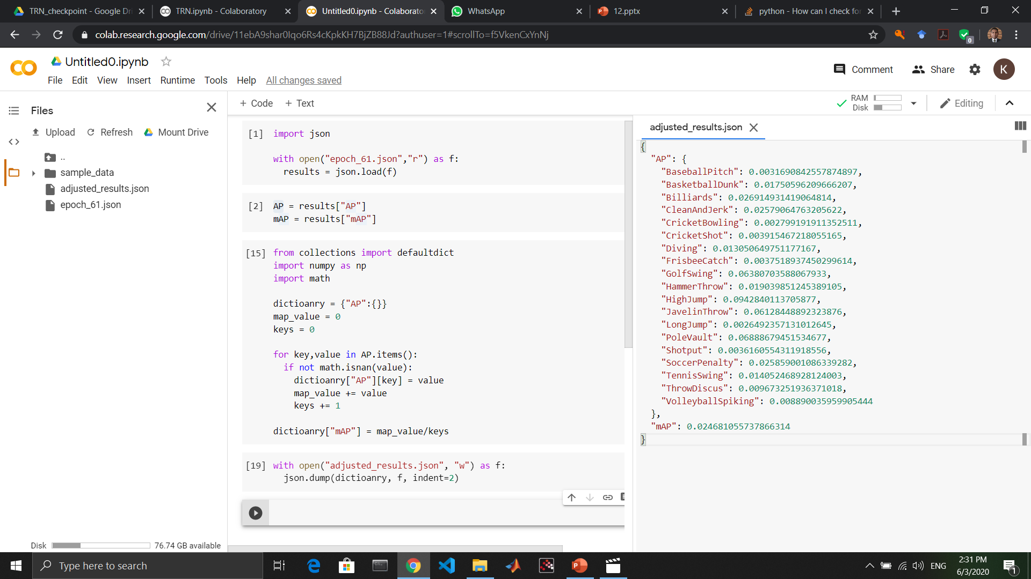
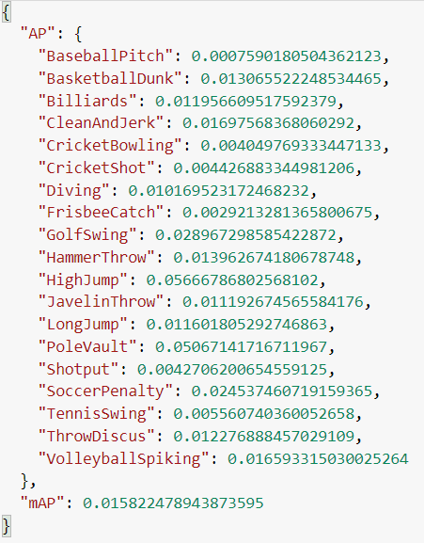
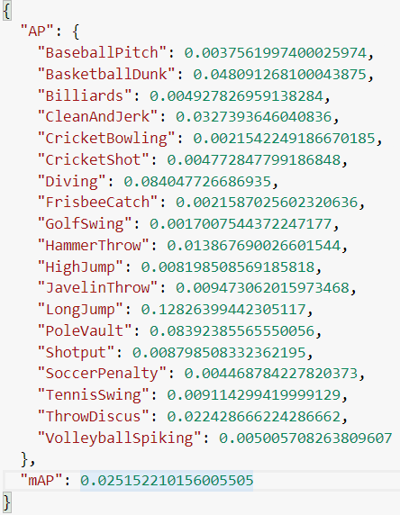
[1] RGB features -> Centernet
Flow features -> Centernet
[2] RGB features -> ResNet152
Flow features -> Inception BN
[3] RGB features -> ResNet152
Flow features -> Inception BN
Optical flows were calculated using Farneback – without initial flow
Optical flows were calculated using Farneback – with initial flow
Optical Flows are converted to RGB based on FlowNet-2.0 flow2rgb() function
After 61 Epochs
After 11 Epochs
After 12 Epochs

Slide 7
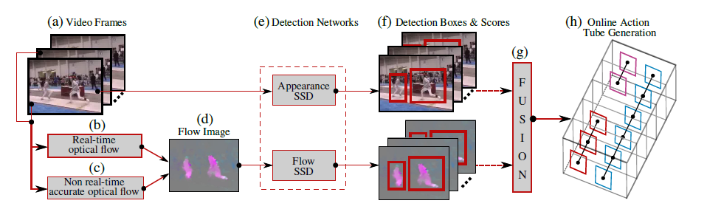
2. Alternative Approach
Online Real-time Multiple Spatiotemporal Action Localisation and Prediction (ICCV-2017)
Online Activity Detection
Spatio-temporal detection
Requires object-level annotation
Has object detection base (Default is VGG16-SSD)
Can change the default for faster runtime
Can incorporate regular object detection with activity detection

Slide 8
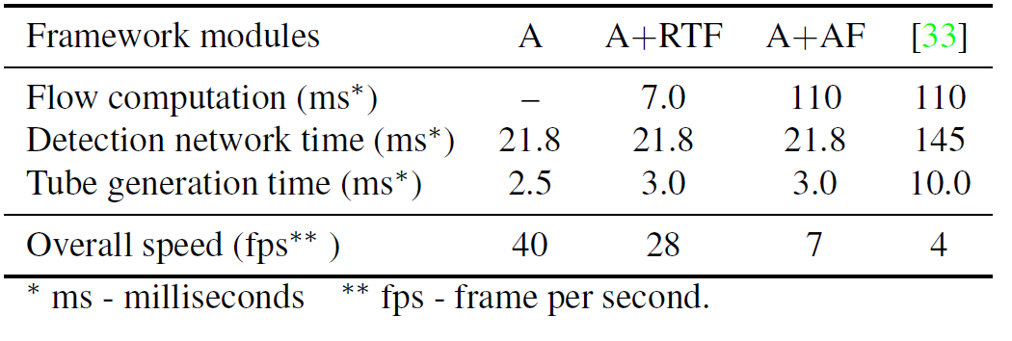
Inference Time
Initial Results
Only RGB Images
VGG16-SSD
Author’s pretrained model
Results
IoU 0.2: 0.714 mAP
IoU 0.5: 0.4 mAP
These are similar results to what is reported in the paper.
Using a desktop computer with an Intel Xeon CPU@2.80GHz (8 cores) and two NVIDIA Titan X GPUs

Slide 9

Tasks for next week
Work on the Feasibility Study report and presentation
Work on the alternative method of Activity Detection

